Slide 1
Introduction to Web Mapping
Geocode.sa

Slide 2
What is web mapping?
A web map is an interactive display of geographic information, in the form of a web page, that you can use to tell stories and answer questions.
In the past, most digital geographic information was confined to specialized software on desktop PCs and could not be easily shared.
With the advent of web mapping, geographical information can be shared, visualized, and edited in the browser. The most important advantage to this is accessibility: a web map, just like any website, can be reached by anyone from any device that has an internet browser and an internet connection.

Slide 3
What is web mapping?
Web maps are interactive. The term interactive implies that the viewer can interact with the map.
Web maps are useful for various purposes, such as data visualization in journalism (and elsewhere), displaying real-time spatial data, powering spatial queries in online catalogs and search tools, providing computational tools, reporting, and collaborative mapping.

Slide 4
Examples of Web maps
Purpose | Example
Visualization and journalism | Global Migration Ship Traffic
Real-time information | Earth Weather Real-Time Transport Location Real-Time Flight Locations Stuff in Space
Catalog and search | Earth Data Search
Computational tools | Google Maps Sun Calc geojson.io Mapshaper Route Planner
Reporting and collaboration | OpenStreetMap Falling Fruit

Slide 5
Examples of Web maps
https://earth.nullschool.net/
https://www.shipmap.org/
https://zola.planning.nyc.gov/
http://stuffin.space/

Slide 6
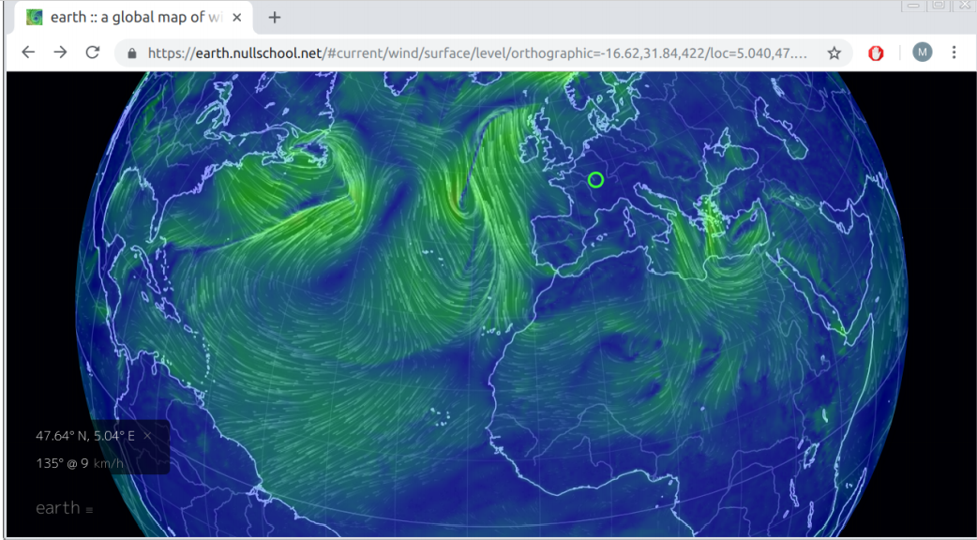

Slide 7
Examples of Web maps
https://earth.nullschool.net/
https://www.shipmap.org/
https://zola.planning.nyc.gov/
http://stuffin.space/

Slide 8
Web Browser
People access the web using software known as a web browser. Popular examples of web browsers are Chrome, Firefox, Edge, Internet Explorer,

Slide 9
Web Server
When you ask your browser for a web page, typing a URL such as https://www.google.com in the address bar, the request is sent across the internet to a special computer known as a web server which hosts the website.
Web servers are special computers that are constantly connected to the internet, and are optimized to send web pages out to people who request them.
Your computer, the client, receives the file and renders the web page you ultimately see on screen.
When you are looking at a website, it is most likely that your browser will be receiving HTML and CSS documents from the web server that hosts the site. The web browser interprets the HTML and CSS code to create the page that you see.

Slide 10
Web Server
The term web server can refer to hardware or software, or both of them working together, for serving content over the internet. On the hardware side, a web server is a computer that stores a website’s component files, such as:
HTML documents
CSS stylesheets
JavaScript files
Other types of files, such as images

Slide 11
Web Server
The server delivers these files to the client’s device. It is connected to the internet and can be accessed through a URL such as https://www.google.com/.
On the software side, a web server includes several parts that control how web users access the hosted files.
The minimal required software component is an HTTP server. An HTTP server is a software component that understands URLs (web addresses) and Hypertext Transfer Protocol (HTTP)—the protocol used by the browser to communicate with the serve. A server with just the HTTP server component is referred to as a static server (Section 5.4.2), as opposed to a dynamic server, which has several additional components.

Slide 12
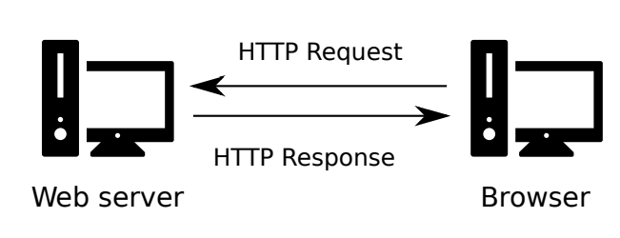
Client-server communication through HTTP

Slide 13
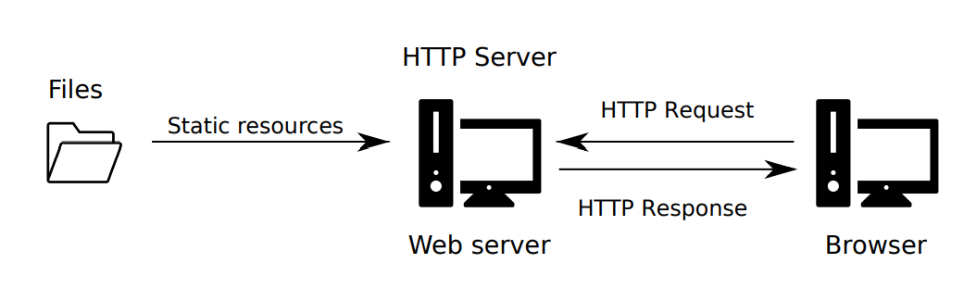
Client-server communication through HTTP

Slide 14
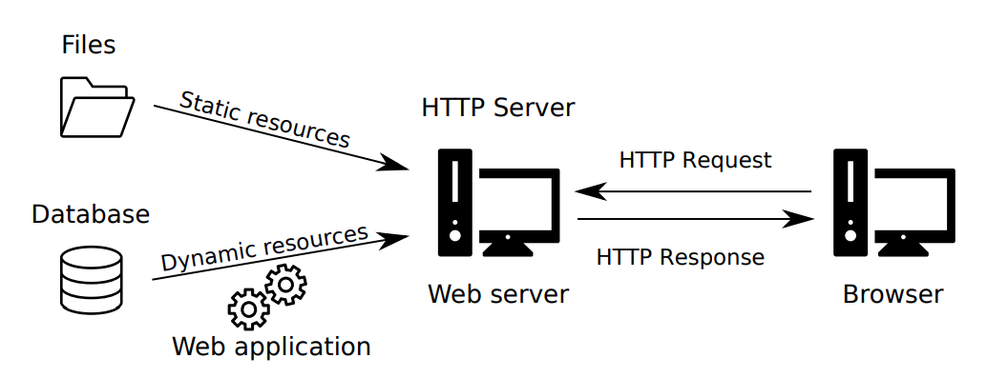
Client-server communication through HTTP

Slide 15
Web Pages
At the most basic level, a web page is a plain text document containing HTML code

Slide 16
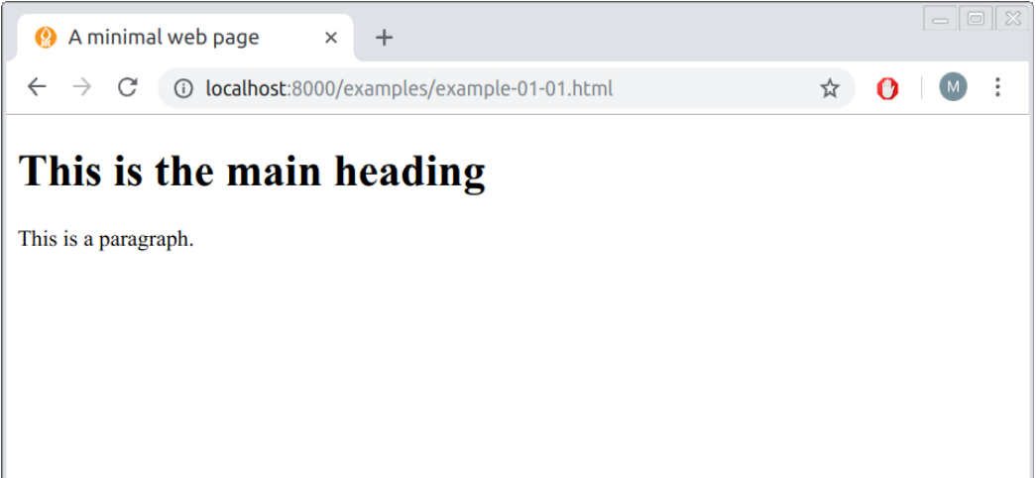
Example of Web page

Slide 17
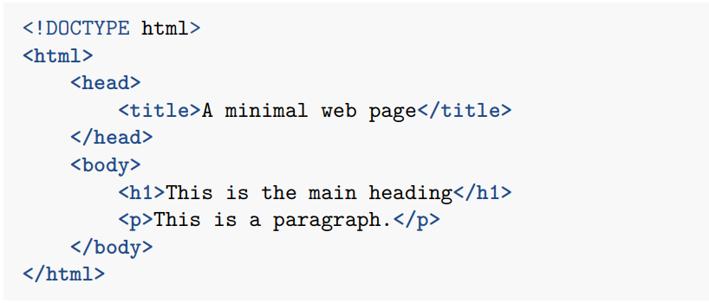
Web Page Source code

Slide 18

What is HTML ?
Hypertext Markup Language (HTML) is the language that describes the contents and structure of web pages.
HTML code consists of HTML elements. An HTML element contains text and/or other elements.
This makes HTML code hierarchical. An HTML element consists of a start tag, followed by the element content, followed by an end tag. A start tag is of the form and an end tag is of the form . The start and end tags contain the element name (elementName).

Slide 19

Empty Tags
Some HTML elements are empty, which means that they consist of only a start tag, with no contents and no end tag.

Slide 20
Empty Tags
An element may have one or more attributes11. Attributes appear inside the start tag and are of the form attributeName="attributeValue".
The following code section shows an example of an <img> element, with an attribute called src.

Slide 21
Exercise
Edit the minimal HTML document example-01-01.html to experiment with the HTML element types we learned in this chapter:
Modify the title of the page and the first-level heading.
Delete the existing paragraph and add a new paragraph with two to three sentences about a subject you are interested in.
Use the appropriate tags to format some of the words in italic or bold font.
Use the tag to add a link to another web page.
Add a list with two levels, i.e., a list where each list item is also a list.
Add images which are loaded from another location on the internet, such as from Flickr

Slide 22
References
Introduction to Web Mapping by Michael Dorman
Getting to Know Web GIS by Pinde

